Slide 1
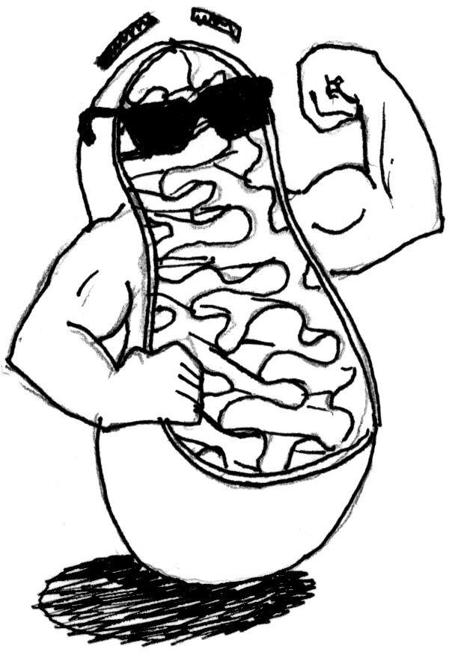
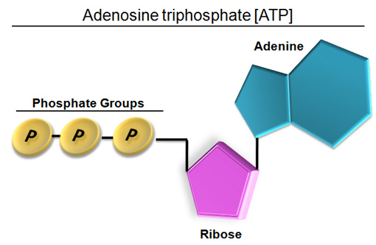
Fermentation
Ms. Day
Honors Biology
Lecture #8

Slide 2
Turn to your partner and discuss…
What do you think would happen to your body if your held your breath for 30 seconds?

Slide 3
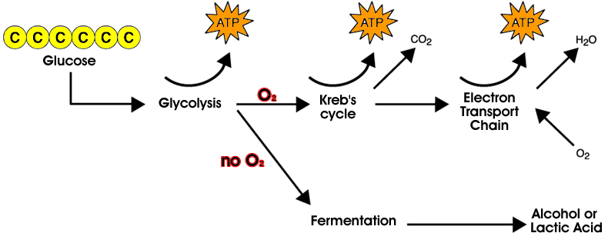
Cellular Respiration vs Fermentation
Sometimes…
You RUN OUT of oxygen gas… like when????

Slide 4
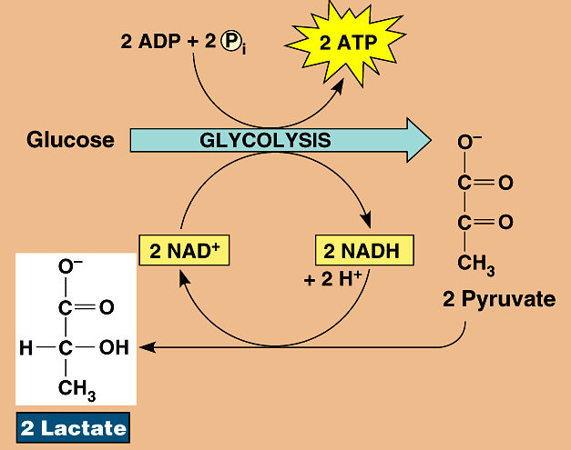
Alcoholic Fermentation
Pyruvate is turned into Alcohol
CO₂ is released (bubbles!)
Who? Yeast and bacteria for brewing and bread making
CO₂ is released
+
Alcohol
(waste)
CO₂
Goal: produce energy carriers to go back to glycolysis to keep it going

Slide 5
Lactic Acid Fermentation
Pyruvate is turned into Lactic acid
Builds up in muscles
Lactic acid eventually breaks down and blood “washes” it away from muscles
Example: Animals w/ muscle cells, bacteria
Lactic acid makes muscles sore after exercise
No CO₂ is released
Lactic Acid
(waste)

Slide 6
Fermentation vs. Cellular Respiration
Similarities:
Both make ATP
Both create NAD+ to be sent back to glycolysis
Differences:
Cellular respiration makes A LOT MORE usable energy (ATP)…much better!
_{NEEDS OXYGEN}
Fermentation makes a little USEABLE energy
NO OXYGEN

Slide 7
Cellular Respiration

Slide 8
Fermentation

